Slide 1
“Flash Mentoring” Training with Smeal Alumni

Slide 2
Agenda
Assessment Questions
Resume Review
Resource Sharing/Web Overview
Nittany Lion Careers and Other Job Posting Sites
Summer Prep
Planning for Fall and the Importance of “Being a Face”

Slide 3
Assessment Questions
What leadership skills have you been building on campus and how have you been building them?
What professional development and networking opportunities have you participated in during your time at Penn State, even if virtual?
What are your goals for an internship? Do you have companies or particular functions in mind?

Slide 4
Resume Review
Focus on format
  1 page
  Consistently formatted
Consult on “power”
Provide high level feedback on bullets
  What, how, why?
  Use of strong action verbs

Slide 5
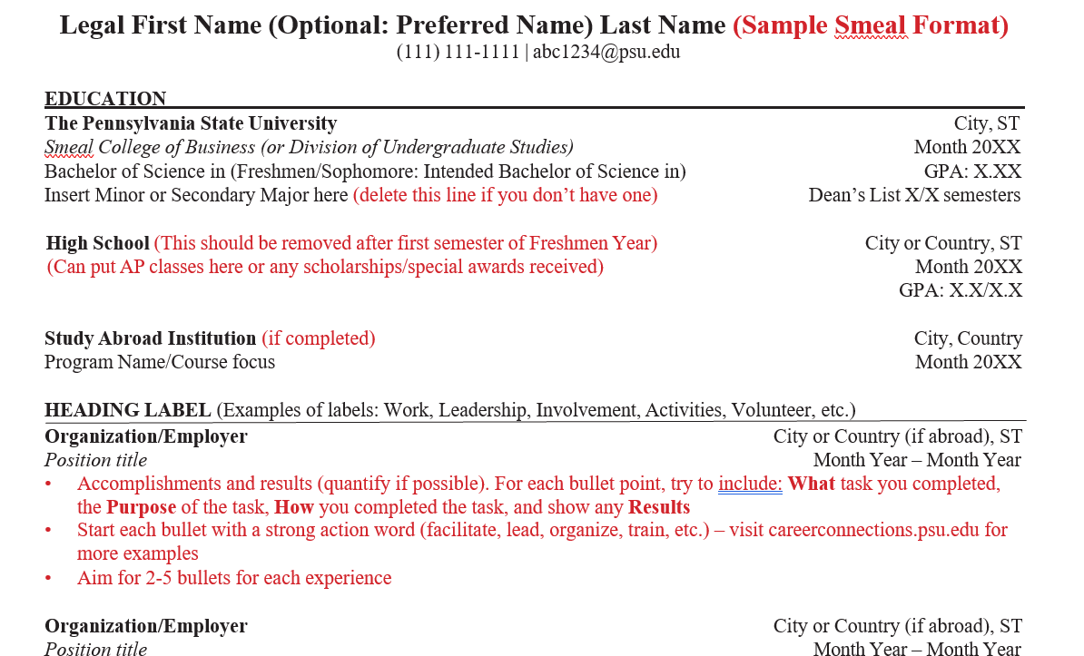
Resume Review

Slide 6
Resources
https://careerconnections.smeal.psu.edu/resources/the-internship-job-search-process/
https://careerconnections.smeal.psu.edu/channels/international-students/
https://careerconnections.smeal.psu.edu/resources/linkedin-resources/
https://careerconnections.smeal.psu.edu/resources/resumes/

Slide 7
Summer Prep
Edit Resume
Get familiar with job search boards
Prepare pitch
Focus on Building Networks
  LinkedIn
  Lion LINK
  Consider Mentoring program for fall

Slide 8

Play the Game: You’re being “watched” in an Applicant Tracking System!
Gather intelligence via networking, LinkedIn, informational interviews
Put a face to a name via networking events/info sessions
Enhance professionalism, have documents “in a row”
Apply, apply, apply
Repeat steps 1-3
Interview 1, 2, 3, or 4 times, take assessments
FINALLY! Negotiate and make a decision!

